Slide 1

Data Formats
Martin Read

Slide 2
Session
JSON
XML

Slide 3
Javascript Object Notation
Objects are created simply by listing their components
Whilst it is part of JavaScript – it is language independent
Is used to exchange data between programmes
Readable by humans
Easy to use, easy to implement
JSON originally specified in early 2000’s
Official website launched 2002
Notes:
Json data – key value pairs put into a list
There's no special tool that creates it, but needs to be in the right format - otherwise, when it's being consumed (parsed), it can cause problems.
Language independent, even though it is part of the Javascript family
You can read it - it makes sense as you go through it.
Has been around for a while.

Slide 4
JSON Syntax
6 kinds of values
Objects
Arrays
Strings
Numbers
Booleans
null
Notes:
Syntax within the key value pairs.
A number does not have quotes around it - a string has quotes around it.

Slide 5
JSON Object
An unordered container of key value pairs
Name can be any string
Value can be any JSON value shown before
Can be nested to any depth
But best practice is to keep it fairly flat
Most languages map values to features
Eg: objects, structures, records etc.
Notes:
There is no order to the data - if you have an email & password coming in as Jason Data it doesn't matter which order they are so long as they exist & are separated by a comma.
You can nest Json data really deep - but avoid this as it will take forever to process
Any language you are coding in will be able to pick up some of those structures. There will be primitives for the coding language - it can recognise a string, a number, etc
Some translating from the incoming data into an object that can then be operated on.

Slide 6
JSON Array
An ordered sequence of values
Values as before
Other languages map using arrays, vectors, lists
Notes:
Arrays present in various languages.
JSON Arrays - an ordered sequence of values, that map onto different array values, vectors or lists in whatever language you choose.

Slide 7
JSON string and number
Wrapped in double quotes
Use \ for escaping
Leading zero not allowed on integers
Numbers just like JavaScript numbers
Notes:
A string is in double quotes.
If you have something that needs double quotes inside the content, you need to escape it using a backslash.
It does not use the leading Zero in front of integers - you cant have 02, 03, etc – it is 2, 3, etc.

Slide 8
Example of an Object
“categories” :
{
“category” : [”From”, “Subject”, “Date”]
}
Notes:
An object, such as a categories object with data within that - category has [a from, a subject & a date].
A way of formatting data to go through Webservices.

Slide 9
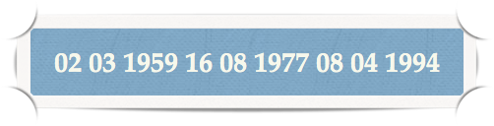
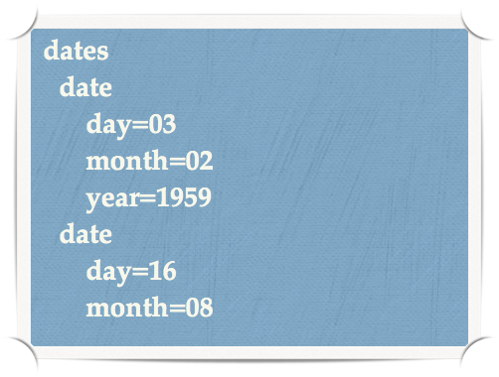
Semi-structured Data
Structured data - just data
Semi-structured data
Human readable
Self-describing
labels
Notes:
If you think of data in general - you've got structured data - might be present as just data
Or can be made human readable – Semi-structured data
These is a date - 3rd of the 2nd, 1959
We can apply labels – making more sense of the data

Slide 10
XML
Notes:
XML is another way of structuring data.

Slide 11
eXtensible Markup Language
Official recommendation of W3C
Version 1 released 1998
Metalanguage
Markup describes properties of data
Designed to be semi-structured
Designed to be extensible
Eg define own terms and markup
Notes:
It is a markup language, allowing you to describe the different properties of data - it doesn't create an interface – that is what you have HTML for

Slide 12
Why XML?
Data description language
Formal description of data structure and grammar
but not semantics
Exchange of data - eg: inside web services
Standardisation
Avoids many different file formats
You determine the tags
Notes:
Essentially a data description language, you can enforce certain ways of structuring and can be standardised.
Gets away from lots of file formats.
You determine what goes into that mark-up - what the tags are.

Slide 13

XML Components
Tags
Attributes (in start tags)
Has namespaces, elements
Conform with DTD or Schema
Essential in business to business transactions
Notes:
You have attributes inside the tags.
XML version – this is an attribute – the version being used
You can determine what goes in by having a document - a DTD. The schema is a bit more flexible
Says whatever goes in has got to have these items - allows a check before the XML gets sent off, before the transaction is carried out - making sure that the important data is in there.

Slide 14
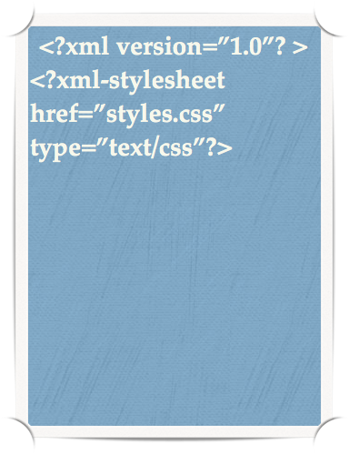
Processing instructions
XML is data!
Needs processing instructions to know how to display it
Processing instructions provide information to the applications to know how to process the document
Browsers, tools know what to do
Has special tags that include ?
Example is processing instruction including a CSS stylesheet to an XML document
Notes:
XML needs to have some instructions on how to deal with it. How to style it - so you might have a stylesheet - CSS.
These are processing instruction - going to be your outputs in the browser. XML is not dealing with the output to the screen, the CSS is.

Slide 15
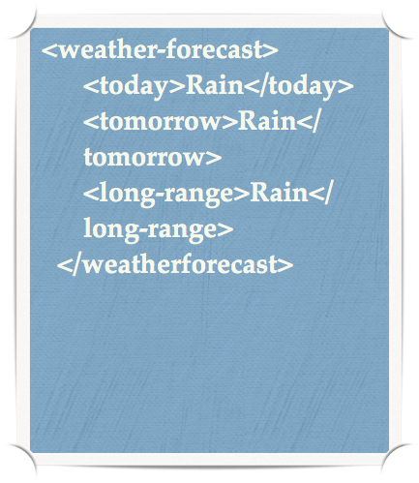
Elements
XML must contain a minimum of one root document (<weather-forecast>)
Content is parsed character data (Rain)
Can omit the XML declaration - 1.0 is default.
Notes:
Must have an element – a Root document
Inside the tag level are your attributes.
You can enhance the elements with different descriptors

Slide 16
Attributes vs elements
Cannot have multiple attributes of same name in same element
Attributes are less flexible if you want to change structure later
Attributes cannot be used to describe hierarchical structures
Attributes are more difficult to manipulate by software programs that process XML
Cannot specify a meaningful order of attributes in an element
Notes:
You cannot have the same attribute in there twice - got to think about what it is you're using to describe it.
They are more difficult to extract when you're coding, try not to overuse attributes as opposed to elements.
Elements are part of the structure

Slide 17
Attribute uses
Represents metadata
Unique IDs for elements
References external entities - such as files
Can result in better processing speed
often used for system configuration
Notes:
if you've got an extract from the database, you might find an ID with a value
you can have elements that change
Quite often this approach is used for the configuration – if you look at WEB.CONFIG in an ASP.net application you will see that that is giving instructions for the server to manage deploying that application.

Slide 18
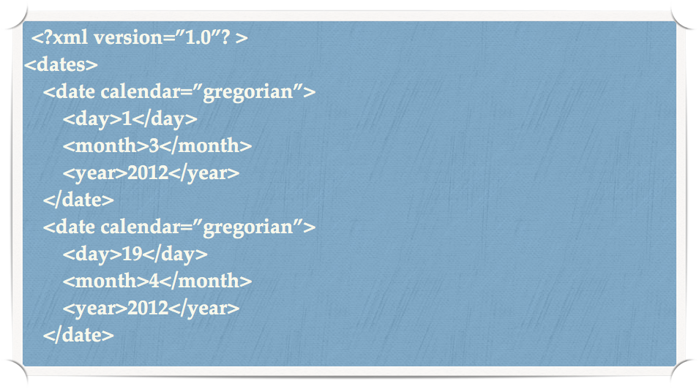
Example
Notes:
Dates – a type of Calendar.
calendar attribute, could be changed.
elements – day, month, year.

Slide 19
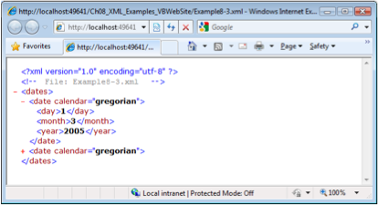
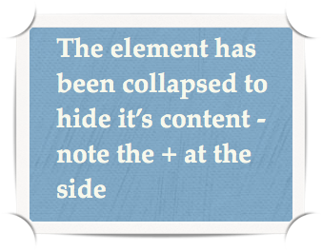
XML in browser
Remember - it’s just data => no presentation markup
Rendering is browser dependent
Notes:
How it is viewed is very dependent on the browser - Chrome will do things very differently to Internet Explorer, etc.
Sometimes they'll all be collapsed, sometimes opened up - depends on that browser at that moment in time.

Slide 20
Document Type Definitions (DTD) and XML Schemas (1 of 2)
File with .dtd extension that describe XML elements
Provides composition of database’s logical model
Defines the syntax rules or valid tags for each type of XML document
Companies engaging in e-commerce transaction must develop and share DTDs
DTD referenced from inside XML document
Notes:
document type definitions - if you need to ensure what goes into the XML file
e.g. car rental - needs have a place where you can look everything up - type of car, etc
When companies negotiate the e-commerce transactions/e-commerce business, they will determine what goes into those exchanges.

Slide 21
Document Type Definitions (DTD) and XML Schemas (2 of 2)
XML schemas
Advanced data definition language
Describes the structure of XML data documents
More closely maps to database terminology and features
XML schema definition (XSD) file uses syntax similar to XML document
Notes:
DTD can be painful
XML schemas may be easier.
An XML schema to describe XML.

Slide 22
XPath
XPath (XML Path) provides a language for accessing parts of the XML document
Used by XML Stylesheet language Transformations (XSLT)
An XPath expression allows you to filter data in an XML file and return only a subset of the file.
XPath traverses the XML file as if it were a tree of nodes
processes elements and attributes
Notes:
Xpath can be very powerful - the query language for XML.
You are not expected to understand this – just to know it exists.
Basically traversing through the XML file - not efficient, which is why you use different things for extracting data.
But if you needed to pick out a certain element – in the weather, pick out the day - might use XPath.

Slide 23
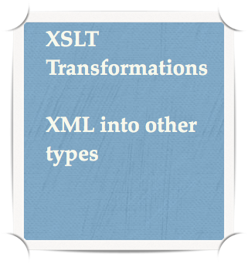
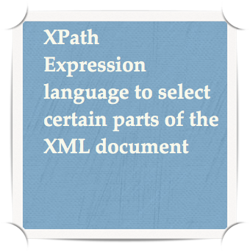
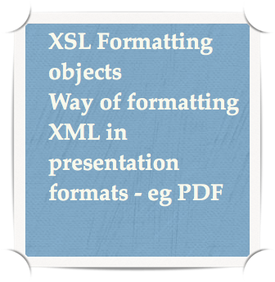
XSLT
A set of standards for XML document transformation and presentation
3 parts
Notes:
You might want to transform your XML into something else – e.g. a mixture of HTML & XML or you want it as a PDF – you might use XSLT
Helps format things

Slide 24
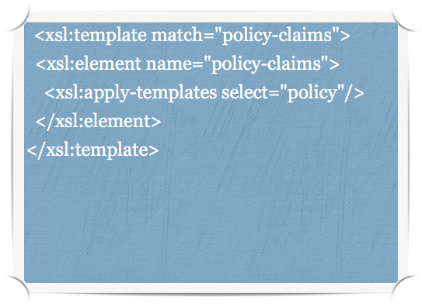
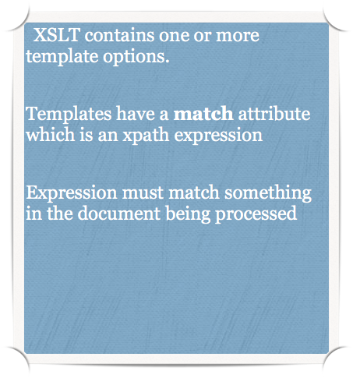
Example
Notes:
Example of a template - looking for a certain type of match within the XML
Then applies certain formatting.

Slide 25
https://www.guru99.com/json-vs-xml-difference.html
Useful summary to see differences between the two
Notes:
if you want to delve a little bit more…

Slide 26

University of Plymouth
Advancing knowledge, transforming lives

